Slide 1

CAREERROUTE AI: INTELLIGENT RESUME MATCHING, SKILL GAP LEARNING AND INTERVIEW ROUTE OPTIMIZE
Team Members:
SWATHI M 2303717610422125
SWETHA M 2303717610422126

Slide 2
INTRODUCTION
CAREERROUTE AI: intelligent resume matching, skill gap learning and interview route optimize Project is an intelligent application that helps candidates understand how well their resumes match a particular job description and what they need to improve to prepare for the role.
The system combines Artificial Intelligence, Natural Language Processing, and search algorithms to perform three major tasks:
Resume–Job Matching: Compares resumes with job descriptions and ranks candidates based on their estimated match.
Skill Gap and Career Path Analysis: Identifies missing skills and suggests a learning order with estimated study duration.
Interview Route Optimization: Finds an efficient order for visiting multiple interview locations.
The application brings resume analysis, career preparation, and interview travel planning together in one platform.

Slide 3
PROBLEM STATEMENT AND OBJECTIVE
Problem Statement:
Manually comparing resumes with job descriptions is time-consuming.
Candidates may find it difficult to identify missing skills and the right learning order.
Planning study duration without considering skill prerequisites can be inefficient.
Visiting multiple interview locations without route optimization may increase travel distance.
Objectives:
Automatically compare resumes with job descriptions and rank multiple resumes.
Identify matching skills, missing skills, and possible resume improvements.
Generate a prerequisite-based learning path and estimate study duration.
Optimize interview visit sequences using geographic distance and search algorithms.
Present all results through a single, user-friendly application.

Slide 4
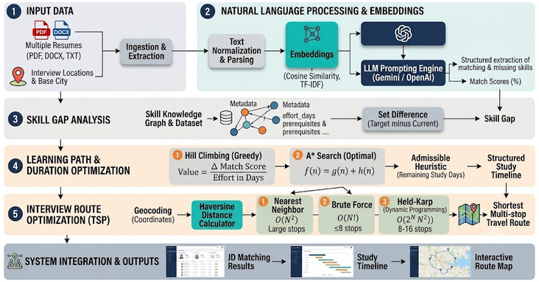
ARCHITECTURE:

Slide 5
MODULES:
Module 1: Resume Dataset Input and Document Processing
Accept multiple resumes in PDF, DOCX, and TXT formats, along with the target Job Description (JD). Extract and normalize the resume text so that different document formats can be processed consistently.
Tech Stack: Python, pypdf, pdfplumber, python-docx
Module 2: Resume–Job Description Matching
Compare resume content with job requirements using text-vector similarity. Use an LLM to extract matching skills, missing skills, match scores, and resume-improvement recommendations. Rank multiple resumes based on their estimated match scores.
Tech Stack: Python, TF-IDF and/or Embeddings, LangChain, configured LLM provider (Gemini / Groq / OpenAI)
Module 3: Skill Gap Analysis
Compare the candidate’s existing skills with the skills required by the job description. Identify missing skills using set difference and retrieve their prerequisites, categories, and estimated learning effort from the skill dataset.
Tech Stack: Python, JSON, Skill Knowledge Graph / Prerequisite Data

Slide 6
MODULES:
Module 4: Learning Path and Study Duration Optimization
Generate a learning sequence that considers skill prerequisites and estimated study effort. Hill Climbing prioritizes skills based on estimated match-score improvement per study day, while A* Search explores paths using accumulated cost and a heuristic for the remaining effort.
Tech Stack: Python, Skill Dataset, Graph Search Algorithms
Module 5: Interview Route Optimization
Calculate geographic distances between the candidate’s base location and interview venues using latitude and longitude. Find an efficient visiting order using different algorithms based on the number of locations.
Tech Stack: Python, Geographic Coordinates, itertools, Dynamic Programming
Module 6: System Integration and Result Visualization
Integrate all three major functions into a single application. Display resume match scores, candidate rankings, missing skills, recommended learning paths, estimated study timelines, and optimized interview routes through a user-friendly interface.
Tech Stack: Python, Streamlit, Interactive Map Component

Slide 7
ALGORITHMS:
Algorithm / Technique | Where It Is Used | Why It Is Used
TF-IDF / Embeddings | Resume matching | Converts resume and job-description text into numerical vectors.
Cosine Similarity | Resume matching | Measures similarity between resume and job-description vectors.
LLM-Based Extraction | Resume analysis | Extracts matching skills, missing skills, and improvement suggestions.
Set Difference | Skill gap analysis | Identifies skills required by the job but missing from the candidate’s skill set.
Prerequisite Traversal | Learning path planning | Identifies foundational skills required before learning advanced skills.
Hill Climbing | Learning path optimization | Greedily selects the currently learnable skill with the highest estimated match improvement per study day.
A* Search | Learning path optimization | Searches for a low-cost learning sequence using accumulated effort and estimated remaining effort.

Slide 8
ALGORITHMS:
Algorithm / Technique | Where It Is Used | Why It Is Used
Haversine Formula | Geographic distance calculation | Calculates approximate distances between locations using latitude and longitude.
Nearest Neighbor | Route optimization | Quickly constructs a route by selecting the nearest unvisited location.
Brute Force | Route optimization | Evaluates all possible visit orders to find the shortest route for a small number of locations.
Held–Karp Dynamic Programming | Route optimization | Reuses solutions to smaller subproblems to find an optimal route with less computational effort than brute force for moderate-sized inputs.

Slide 9
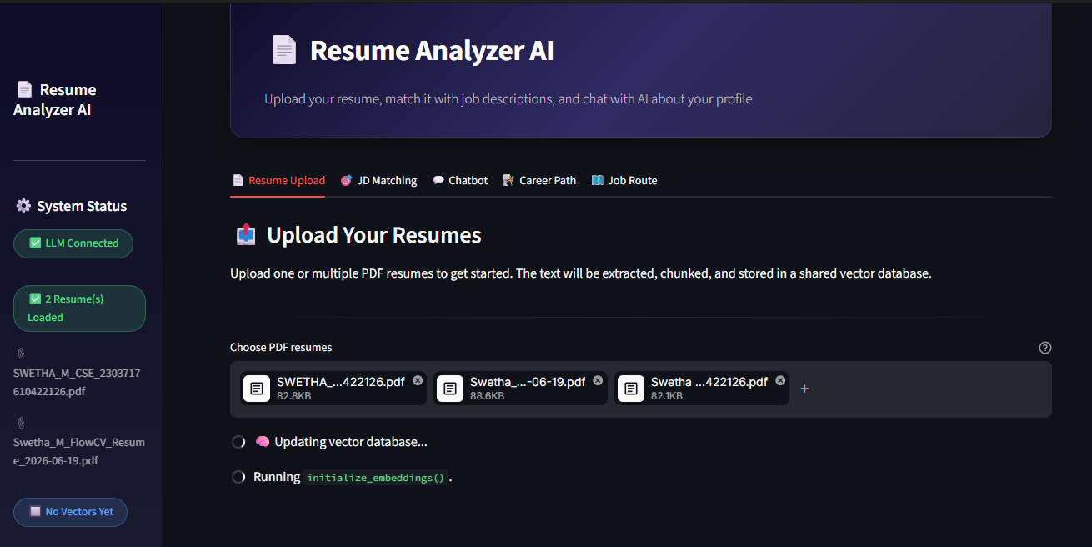
SCREENSHOTS:RESUME UPLOAD

Slide 10
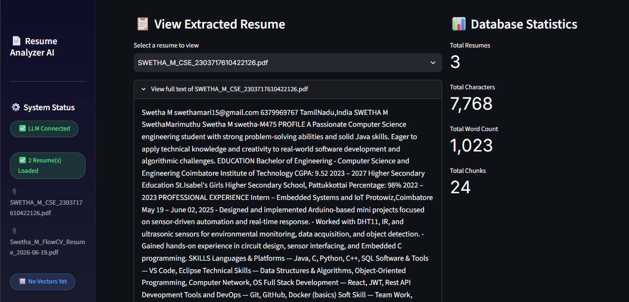
DATA LOADED

Slide 11
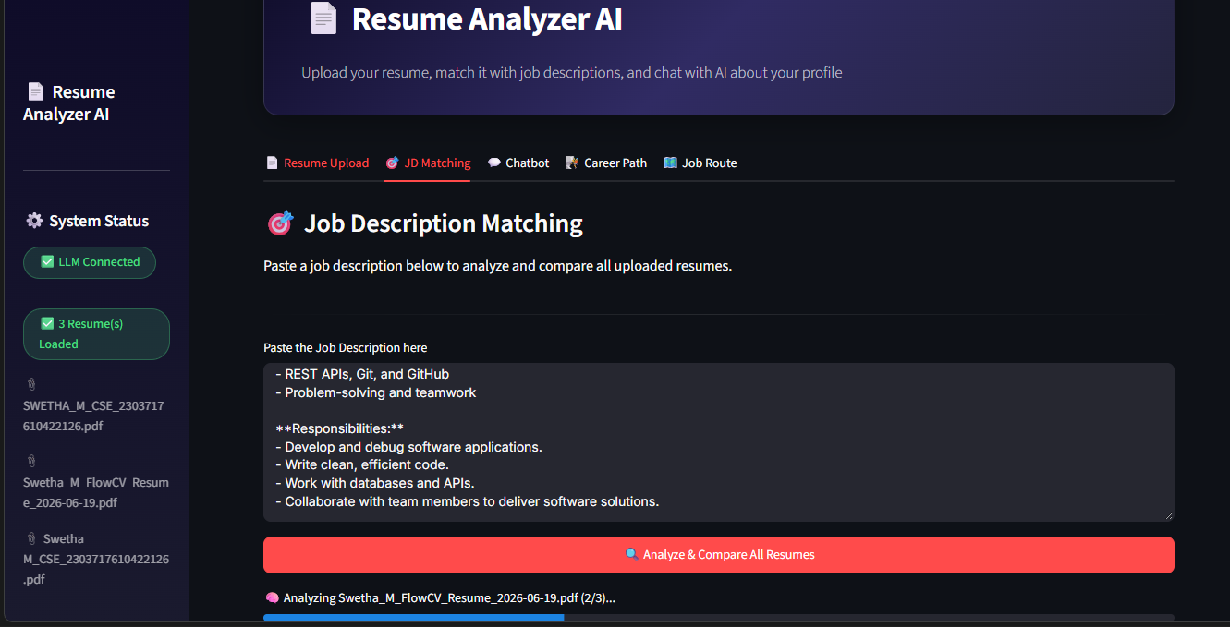
JD MATCER:

Slide 12
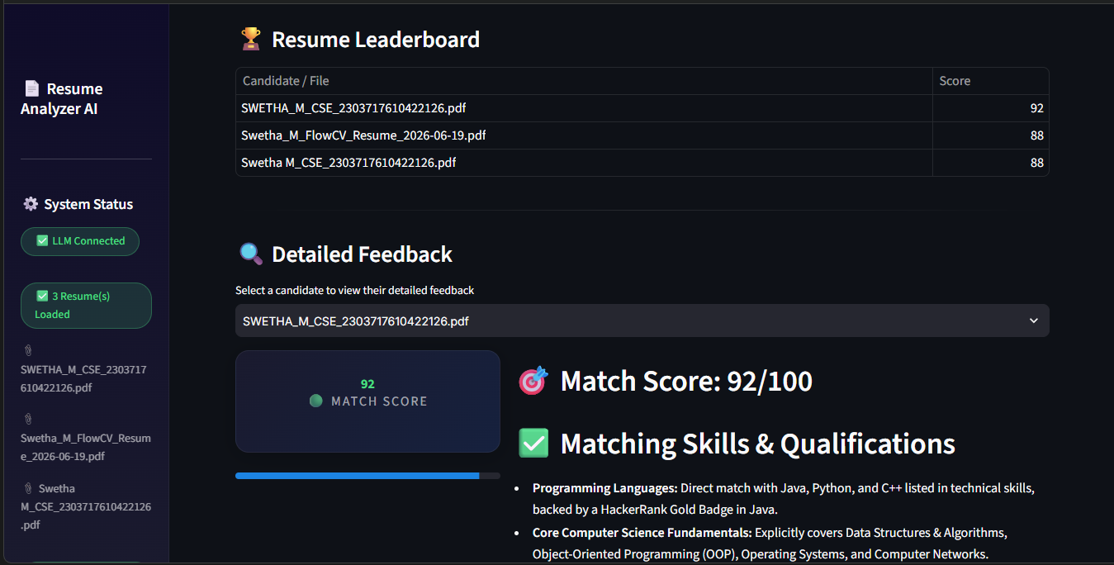
MATCHING SCORE

Slide 13
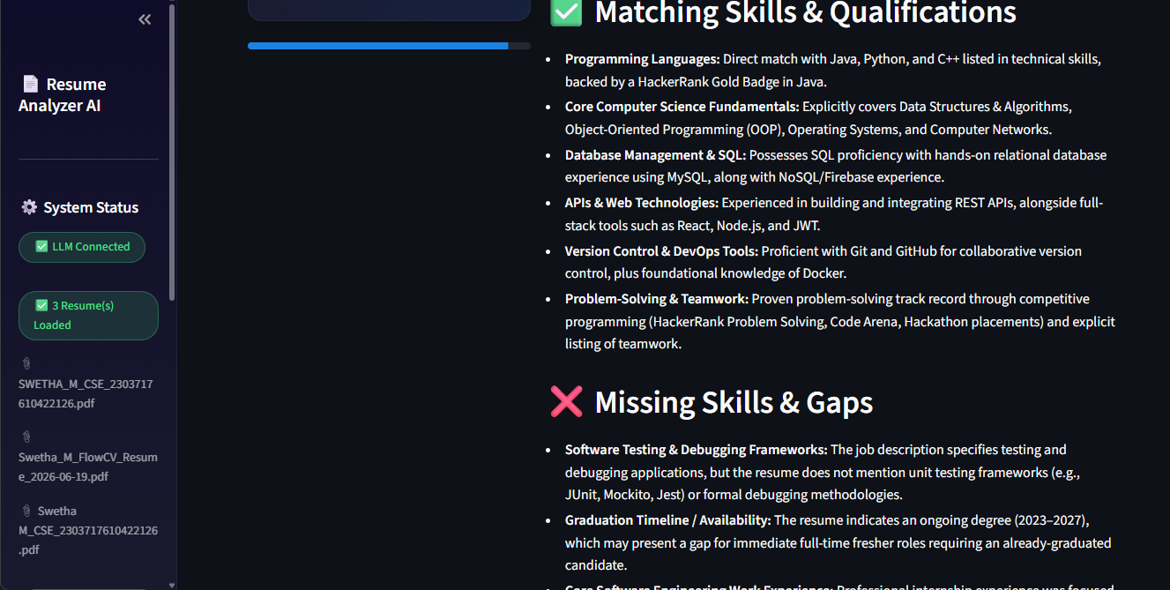
SUGGESTOR:

Slide 14
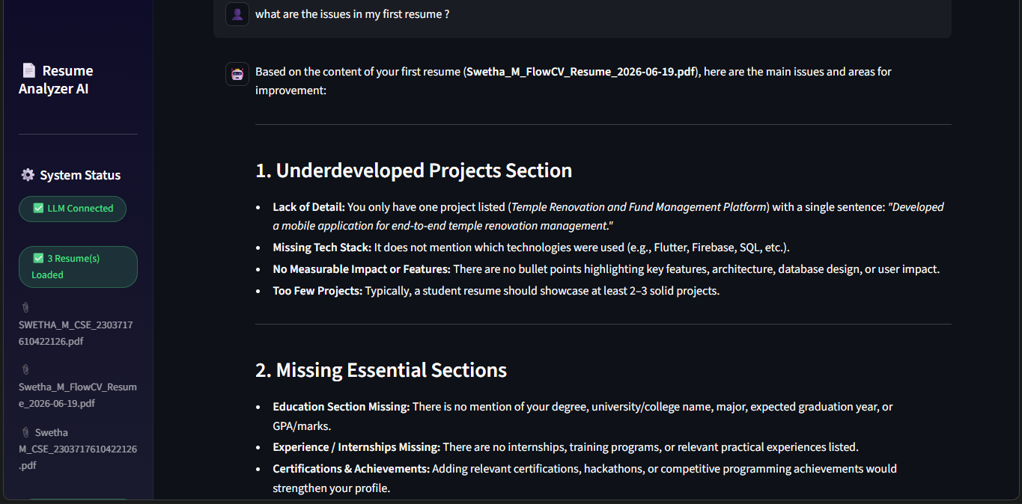
CHATBOT

Slide 15
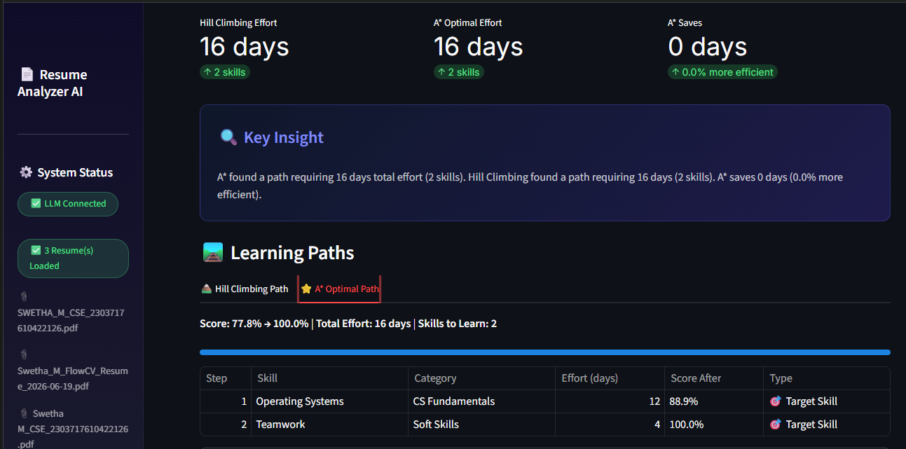
GAPS FINDER AND OPTIMAL STUDY PLAN

Slide 16
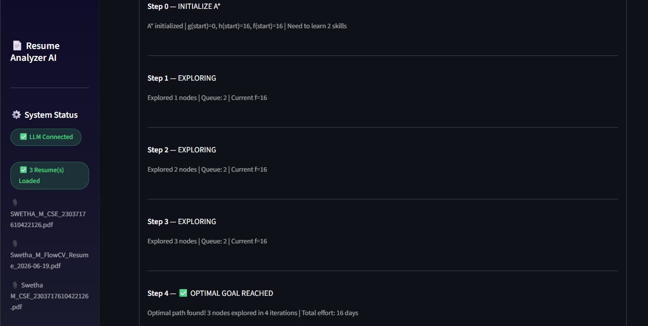
PATH EXPLORED

Slide 17
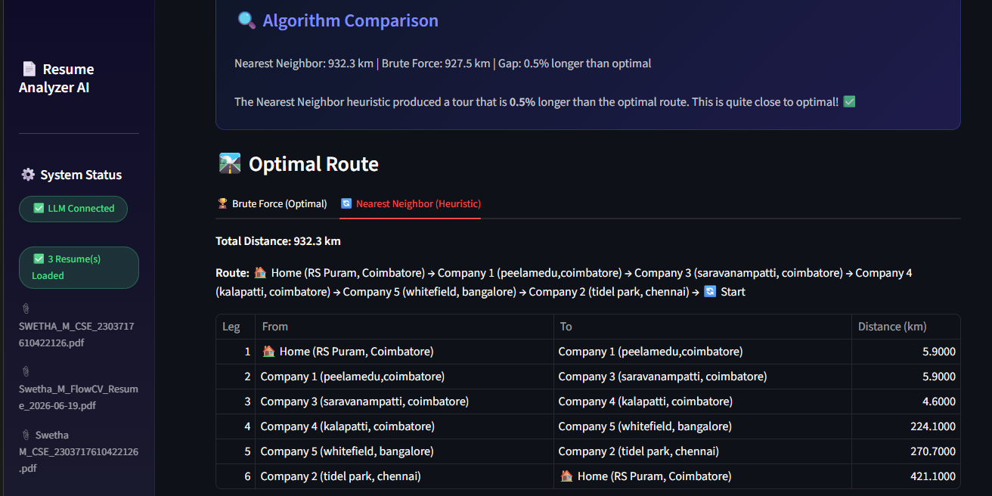
INTERVIEW OPTIMIZED ROUTE FINDER:

Slide 18
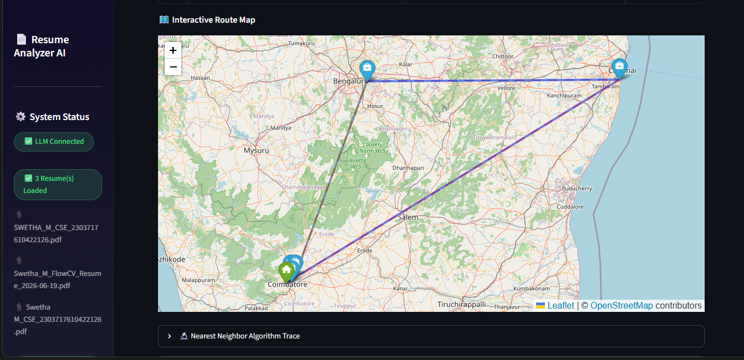
MAP :

Slide 19
THANK YOU …

